Slide 1

Just a test
Powerpint web app

Slide 2
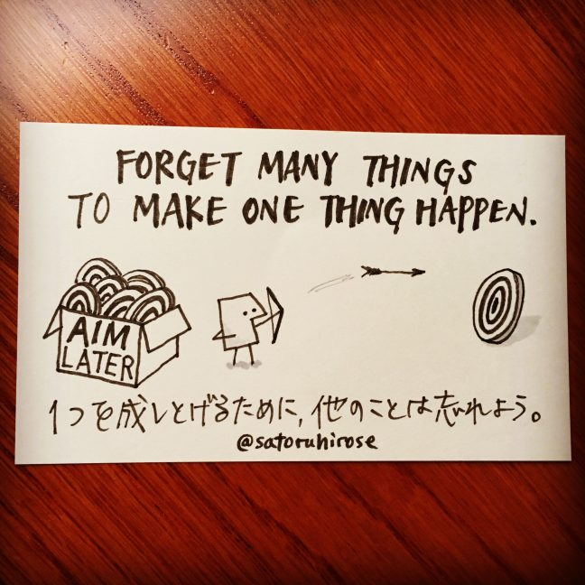
Test2
Powerpoint web app
Powerpoint online

